Slide 1
Distributed Systems
Y. V. Lokeswari AP / CSE
Reference: George Coulouris, Jean Dollimore and Tim Kindberg, “Distributed Systems Concepts and Design”, Fifth
Edition, Pearson Education, 2012

Slide 2
Overview
Introduction
Examples of Distributed Systems
Trends in Distributed Systems
Focus on Resource sharing

Slide 3
Distributed Systems
Distributed system is one in which hardware or software components located at networked computers communicate and coordinate their actions only by passing messages.
Issues in DS
Concurrency
No Global Clock
Independent Failures

Slide 4
Distributed Systems Issues
Concurrency
Concurrent program execution is the norm
Coordination of concurrently executing programs that share resources is must.
No global clock
Co-ordination depends on time at which programs’ action occur.
Limits to the accuracy with which the computers in a network can synchronize their clocks.
There is no single global notion of correct time.

Slide 5
Distributed Systems Issues
Independent Failures
Faults in the network result in the isolation of the computers (will not stop running)
failure of a computer, or the unexpected termination of a program somewhere in the system (a crash), is not immediately made known to the other components with which it communicates.

Slide 6
Applications of DS
Finance and commerce | eCommerce e.g. Amazon and eBay, PayPal, online banking and trading
The information society | Web information and search engines, ebooks, Wikipedia; social networking: Facebook and MySpace.
Creative industries and entertainment | online gaming, music and film in the home, user-generated content, e.g. YouTube, Flickr
Healthcare | health informatics, on online patient records, remote monitoring of patients
Education | e-learning, virtual learning environments; distance learning
Transport and logistics | GPS in route finding systems, map services: Google Maps, Google Earth
Science | The Grid as an enabling technology for collaboration between scientists
Environmental management | sensor technology to monitor earthquakes, floods or tsunamis

Slide 7
Examples of Distributed Systems
Web Search
Task of a web search engine is to index the entire contents of the World Wide Web.
Web consists of over 63 billion pages and one trillion unique web addresses.
Google web search engine consists of the following.
physical infrastructure
distributed file system
distributed storage system
distributed locking and agreement;
programming model (parallel and Distributed
computing)

Slide 8
Examples of Distributed Systems
Massively multiplayer online games (MMOGs)
Sony’s EverQuest II and EVE Online from the Finnish company CCP Games
fast response times
real-time propagation of events to many players and maintaining a consistent view of the shared world.
EVE Online, utilizes a client-server Architecture
EverQuest adopts Distributed systems architecture
Researchers look for peer- to - peer technology.
every participant contributes resources
(storage and processing) to accommodate the game.

Slide 9
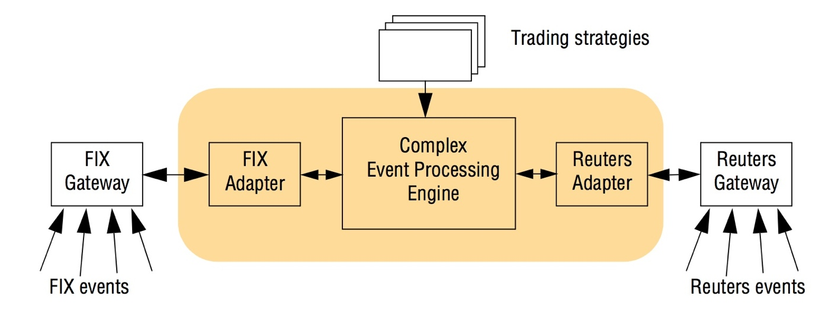
Examples of Distributed Systems
Financial trading
communication and processing of items of interest, known as events in distributed systems.

Slide 10
Focus on resource sharing
Sharing data in the form of a shared database or a set of web pages.
Computer-supported cooperative working (CSCW)
A group of users who cooperate directly share resources such as documents in a small, closed group.
Service : Manages a collection of related resources and presents their functionality to users and applications
(File service - read, write, delete - operations on files)

Slide 11
Focus on resource sharing
Server: A running program (a process) on a networked computer that accepts requests from programs running on other computers to perform a service
Client – Server
Client (active- making request)
Server (Passive – Process request)
Remote Invocation
Distributed system written in OO- language
Client object invoking a method upon server object.

Slide 12
Summary
Introduction
Examples of Distributed Systems
Focus on resource sharing

Slide 13
Thank You

